Slide 1

Power up with power platform
March 4th 2022 (Internal Hackathon)
Notes:
Speaker: Jeff Fattic

Slide 2

Welcome!
Case For Change
“Citizen Developer”
Our Goal
Problem Statements for today’s hackathon
Notes:
Speaker: Jeff Fattic

Slide 3

Case for Change​
Microsoft is a PLATFORM company, even more so under Satya. We don’t want to build finished solutions, but instead be the underlying platform that helps everyone achieve more.​
Everyone at Microsoft needs to understand our products at a deeper PLATFORM level.​
In order to defend against churn and grow usage, Customer Success needs to drive additional customer business value beyond initial license sales.​
Power Platform is our no-/low-code solution that empowers everyone to achieve more – and YOU have the opportunity to model this behavior for our customers.​
BE A POWER USER!
Notes:
Speaker: Marta, Jeff Fattic

Slide 4

What is a Citizen developer
Our “low-code” tools are intended to be easy enough for a “citizen developer”. If this is what you are pitching to customers, then you should be proof that it is easy.​
A CSM is NOT allowed to “code with/for” a customer. Scalability - Building to customer requirements takes time and you aren’t really empowering the customer if you are doing it for them.​ Liability - If a problem were to arise, it is critical customers know we are only providing guidance.​
Having said that, you need to develop the ability to “code with/for” so you can provide the guidance needed.
Notes:
Speaker: Jeff Fattic

Slide 5

Our Goal
Collaboration between colleagues.
Help participants take one step further in their Power Platform journey.
Build participants confidence in product depth (and in their own abilities! ☺)
Notes:
Speaker: Scott Dwyer

Slide 6
Problem statements
Digitizing Patient Intake Process
Internal Microsoft Tools
Open Track
Notes:
Speaker: Jeff Fattic

Slide 7

Hacking the 1st step on your “Citizen Developer” Journey​
Ideate: Pick a track and start brainstorming
Build: Develop and deploy a solution using Power Platform. The solution must use one or more of these options:
Power Apps
Power Automate (Flow)
Power BI
Power Virtual Agents
Share (1 hour): The hackathon will conclude with each team presenting their solution. (10 mins per team)
Notes:
Speaker: Jeff Fattic

Slide 8
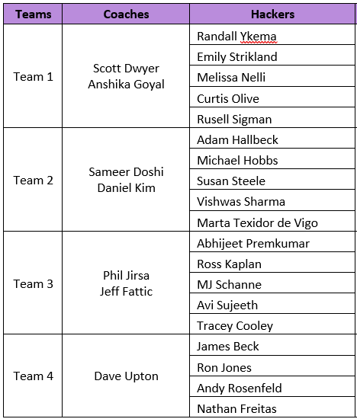
Get hacking!​
Use Meet now in your team’s channel to get started
Notes:
Speaker: Jeff Fattic

Slide 9
DEMo by scott DWYER
Notes:
Speaker: Jeff Fattic

Slide 10
Sharing Session
Presentation order:
Team 1
Team 2
Team 3
Team 4

Slide 11
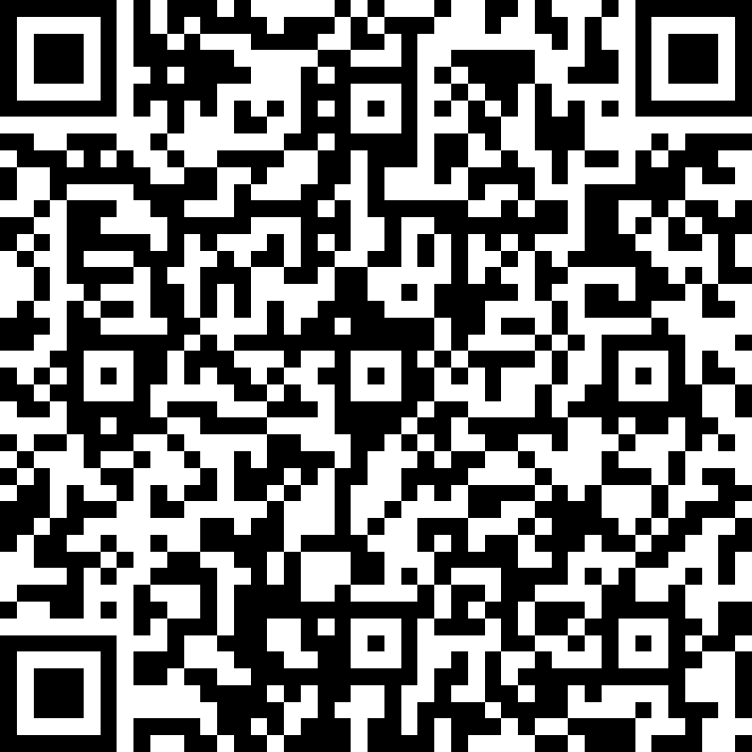
Thank You!
Please give us the good and the bad at https://aka.ms/HackathonEval

